Slide 1

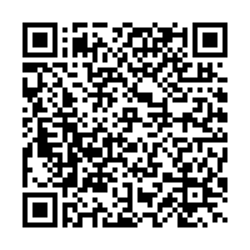
We aim to transform public health research and education by fostering a new generation of scholars committed to health justice, transforming academic institutions, and organizing for community-driven change to create lasting, equitable impact.

Slide 2
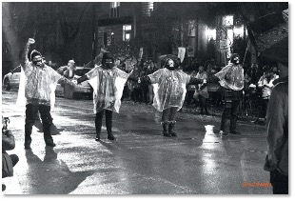
How Community Power Scored an Upset Win for Environmental Justice in Chicago: Reflections on the #StopGeneralIron Struggle
Jim Bloyd (he/him)
Health & Power Organizing Project panel:
Power as a Fundamental Determinant of Health: Empirical Examples
September 13, 2024 11:00 a.m.
Interdisciplinary Association of Population Health Science Annual Meeting
St. Louis, MO September 9-14, 2024
High school students protested December 10, 2021, at public health Commissioner Arwady’s Lincoln Park house. [Credit: Isaiah Sarju @IsaiahSarju ]

Slide 3


















Demanding #DenyThePermit #StopGeneralIron:
WHO IS THE ‘WE’ ?
Southeast Side Educators for Environmental Justice
Partial list

Slide 4
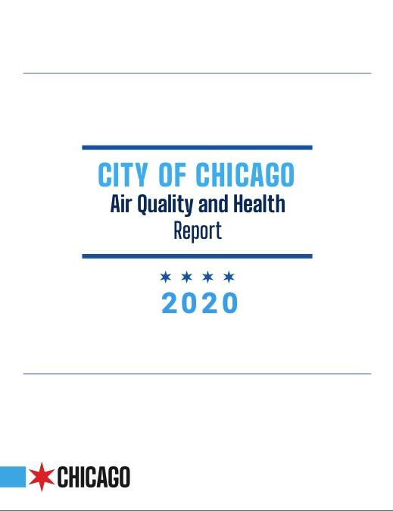
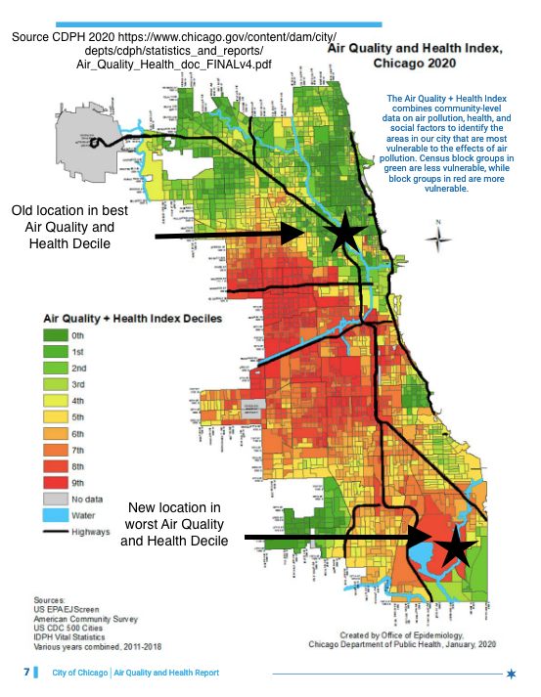
“This brief outlines how the Chicago Department of Public Health (CDPH) analyzed community-level data on air quality, health, and social factors to identify, for the first time, which neighborhoods must be prioritized for efforts to mitigate and reduce air pollution.” p3
Available at: https://www.chicago.gov/content/dam/city/depts/cdph/statistics_and_reports/Air_Quality_Health_doc_FINALv4.pdf
Notes:
Also, Healthy Chicago 2025: https://www.chicago.gov/content/dam/city/depts/cdph/statistics_and_reports/HC2025_917_FINAL.pdf
Life expectancy inequities between Lincoln Park (TOP STAR) and South side community areas:

Slide 5
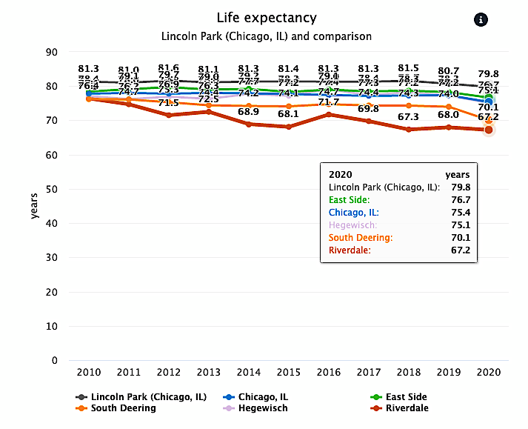
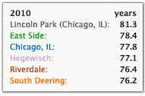
“For the first time in decades, life expectancy for Black residents of Chicago fell below 70 years. Latinx residents saw 3-yr drop between 2019 & 2020.” Source: Mayor’s Press Office April 25, 2022 https://www.chicago.gov/content/city/en/depts/cdph/provdrs/health_data_and_reports/news/2022/april/life-expectancy-in-chicago-declined-during-the-pandemic-s-first-.html Graphic: Chicago Health Atlas
Notes:
(Chicago Dept Public Health April 25, 2022)
As of 2020, the gap in life expectancy between Black and white Chicagoans was ten years, up from 8.8 years in 2017.
For the first time in decades, life expectancy for Black residents of Chicago fell below 70 years
Chicago Latinx residents saw a more than a 3-year drop in life expectancy between 2019 and 2020, the steepest decline for any group, and have lost a total of 7 years of life expectancy since 2012
Asian/Pacific Islander life expectancy showed a 2-year drop from 2019 to 2020, while white Chicagoans’ life expectancy declined by one year
18 to 44-year-old Chicagoans experienced a 45% increase in death rates from 2019, outpacing even 65+ Chicagoans (30% increase) despite COVID’s especially severe impact on that population

Slide 6
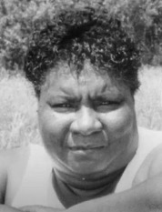
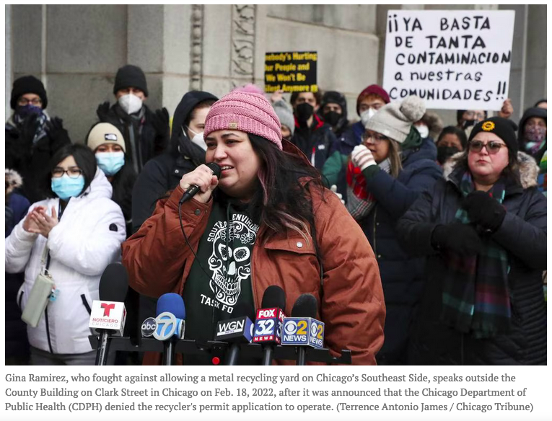
Shifting power is a necessity to advance justice in health
Left: Hazel Johnson (1935-2011): A mother of environmental justice in Chicago
When a people are mired in oppression, they realize deliverance only when they have accumulated the power to enforce change.
Rev. Dr. Martin Luther King, Jr. 1967
Below: Gina Ramirez, who fought against allowing a metal recycling yard on Chicago’s Southeast Side, speaks outside the County Building on Clark Street in Chicago on Feb. 18, 2022, after it was announced that the Chicago Department of Public Health (CDPH) denied the recycler’s permit application to operate. (Terrance Antonio James/Chicago Tribune)
…power and health go together
Jason Beckfield, political sociologist (2018)
King, M. L. (1967, June 11). Martin Luther King Defines “Black Power.” The New York Times Magazine. https://timesmachine.nytimes.com/timesmachine/1967/06/11/83607552.pdf?pdf_redirect=true&ip=0;
Beckfield, J. (2018). Chapter 1 Key Concepts, Measures, and Data. In Political sociology and the people’s health. Oxford University Press. P18.
Notes:
Beckfield full quote [p18]: “For instance, workers had more power with ALMP because it gave them rights that were based in citizenship, not employment, and blacks had less power in Jim Crow because they were stripped of capacities for autonomous action. Since power and health go together, it makes sense that institutional arrangements like Jim Crow contribute to the distribution of premature mortality (Krieger et al., 2013; Riley, 2001).”

Slide 7

Community Power Defined
“…the ability of communities most impacted by structural inequities to develop, sustain, and grow an organized base of people who act together through democratic structures to shift public discourse, set proactive agendas, influence who makes decisions, and cultivate ongoing relationships of mutual accountability with decision makers that change systems and advance health equity.”
Source: Pastor, M., Speer, P., Gupta, J., Han, H., & Ito, J. (2022). Community Power and Health Equity: Closing the Gap between Scholarship and Practice. NAM Perspectives, 6. https://doi.org/10.31478/202206c
Notes:
“the authors have developed a working definition of community power as the ability of communities most impacted by structural inequities to develop, sustain, and grow an organized base of people who act together through democratic structures to shift public discourse, set proactive agendas, influence who makes decisions, and cultivate ongoing relationships of mutual accountability with decision makers that change systems and advance health equity (Pastor et al., 2020c).”
“Community power is about fundamentally making possible what might not seem possible at the start because of structural inequity”
”Individuals with positional power have the responsibility to listen and to work in authentic partnership toward structural or procedural changes”
Quotes source: Pastor, M., Speer, P., Gupta, J., Han, H., & Ito, J. (2022). Community Power and Health Equity: Closing the Gap between Scholarship and Practice. NAM Perspectives, 6. https://doi.org/10.31478/202206c

Slide 8
“Social structure and human agency are co-constitutive” (Beckfield 2018 p9)
“only collective organizing by individuals has ever had the strength to change societal structures.” (Krieger 2021)
Social Structure
Human Agency
Sources: Beckfield, J. (2018). Chapter 1 Key Concepts, Measures, and Data. In Political sociology and the people’s health. Oxford University Press.
Krieger, Nancy. (2021). Ecosocial Theory, Embodied Truths, and the People's Health (Small Books Big Ideas in Population Health) (p. 9 [Page corrected Sept22 2024 jb]). Oxford University Press. Kindle Edition
Notes:
Page 9 Beckfield entire quote: "Although it is certainly true that randomness and simple luck play roles in the distribution of life chances (Jencks, 1972), people are not objects dropped through a quincunx. Indeed, one of the fundamental complexities of social science is that social structure and human agency are co-constitutive. But the quincunx does help in the visualization of how politics and policies structure life chances in spatially and historically varying ways, and we can even elaborate on the classical quincunx by allowing the elements to take on time-varying attributes that a ect path probabilities in systematic ways. Take race, for instance. Race is a system of categorization that creates differential relations between people and their institutional contexts, so it could be incorporated into the quincunx as a variable magnetic eld that would raise or lower the odds of different turning points for different elements of the population, depending upon physical properties of the elements themselves.

Slide 9
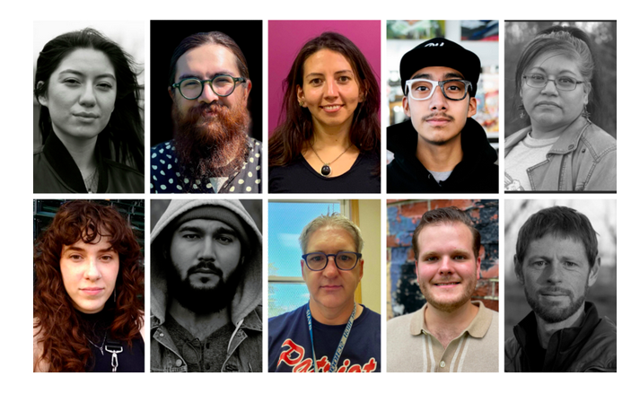
#StopGeneralIron: Anti-racist hunger strike (Feb 2021) to #DenyThePermit
From Top-right clockwise: Jade Mazon, Chuck Stark, Chris King, Donald Davis, Óscar Sanchez, Lauren Bianchi, Yesenia Chavez, Carlos Enriquez, Crystal Vance-Guerra, William ‘Kid’ Guerrero
“How do you organize in a pandemic, during the winter, against such a City-led project? Because ultimately, General Iron had been approved and was given all the green lights by the City despite my community, our neighborhoods saying no.
We had already done petitions, we had already done peaceful marches, we had already done marches at Lori Lightfoot’s house, we had already done all these things. We needed something. And that something was the hunger strike.”
Source & Credit: Jay, C., Sayles, A., Stovicek, O., Vaughn, B., & City Bureau. (2021, November 11). Stories and Lessons from Inside the Stop General Iron Hunger Strike – South Side Weekly. Southside Weekly. https://southsideweekly.com/stories-and-lessons-from-inside-the-general-iron-hunger-strike/
Notes:
“Leadership is the practice of mobilizing people, organizations, and communities to effectively tackle tough public health challenges.” (Begun & Malcolm 2014 p18)

Slide 10
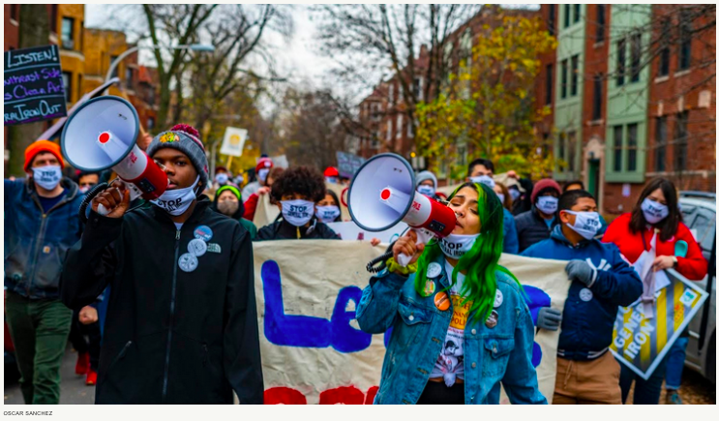
“We are tired of the City treating us like a garbage can.”
Notes:
Photo credit: Oscar Sanchez
High School students Gregory Miller (Left) and Trinity Amari Colón (Right) from Teen Vogue article.
“We grew up believing that everyone had to deal with asthma. Everyone had to use a nebulizer just to breathe, or had a history of lung disease in their family, right? But as we got older, we realized these things were not normal. This is the harsh reality nearly every child in Chicago’s predominantly Black and Latino Southeast Side has to face. We are raised believing factories are a part of everyday life, harsh smells are unavoidable, and having toxic metals in your backyard soil is typical. The Southeast Side is a community where polluting industries are more common than playgrounds…”
Source: Colón, T. A., & Miller, G. (2021, March 24). Environmental Racism in Chicago Will be Made Worse by General Iron Facility. Teen Vogue. https://www.teenvogue.com/story/environmental-racism-chicago-southeast-side-protest

Slide 11
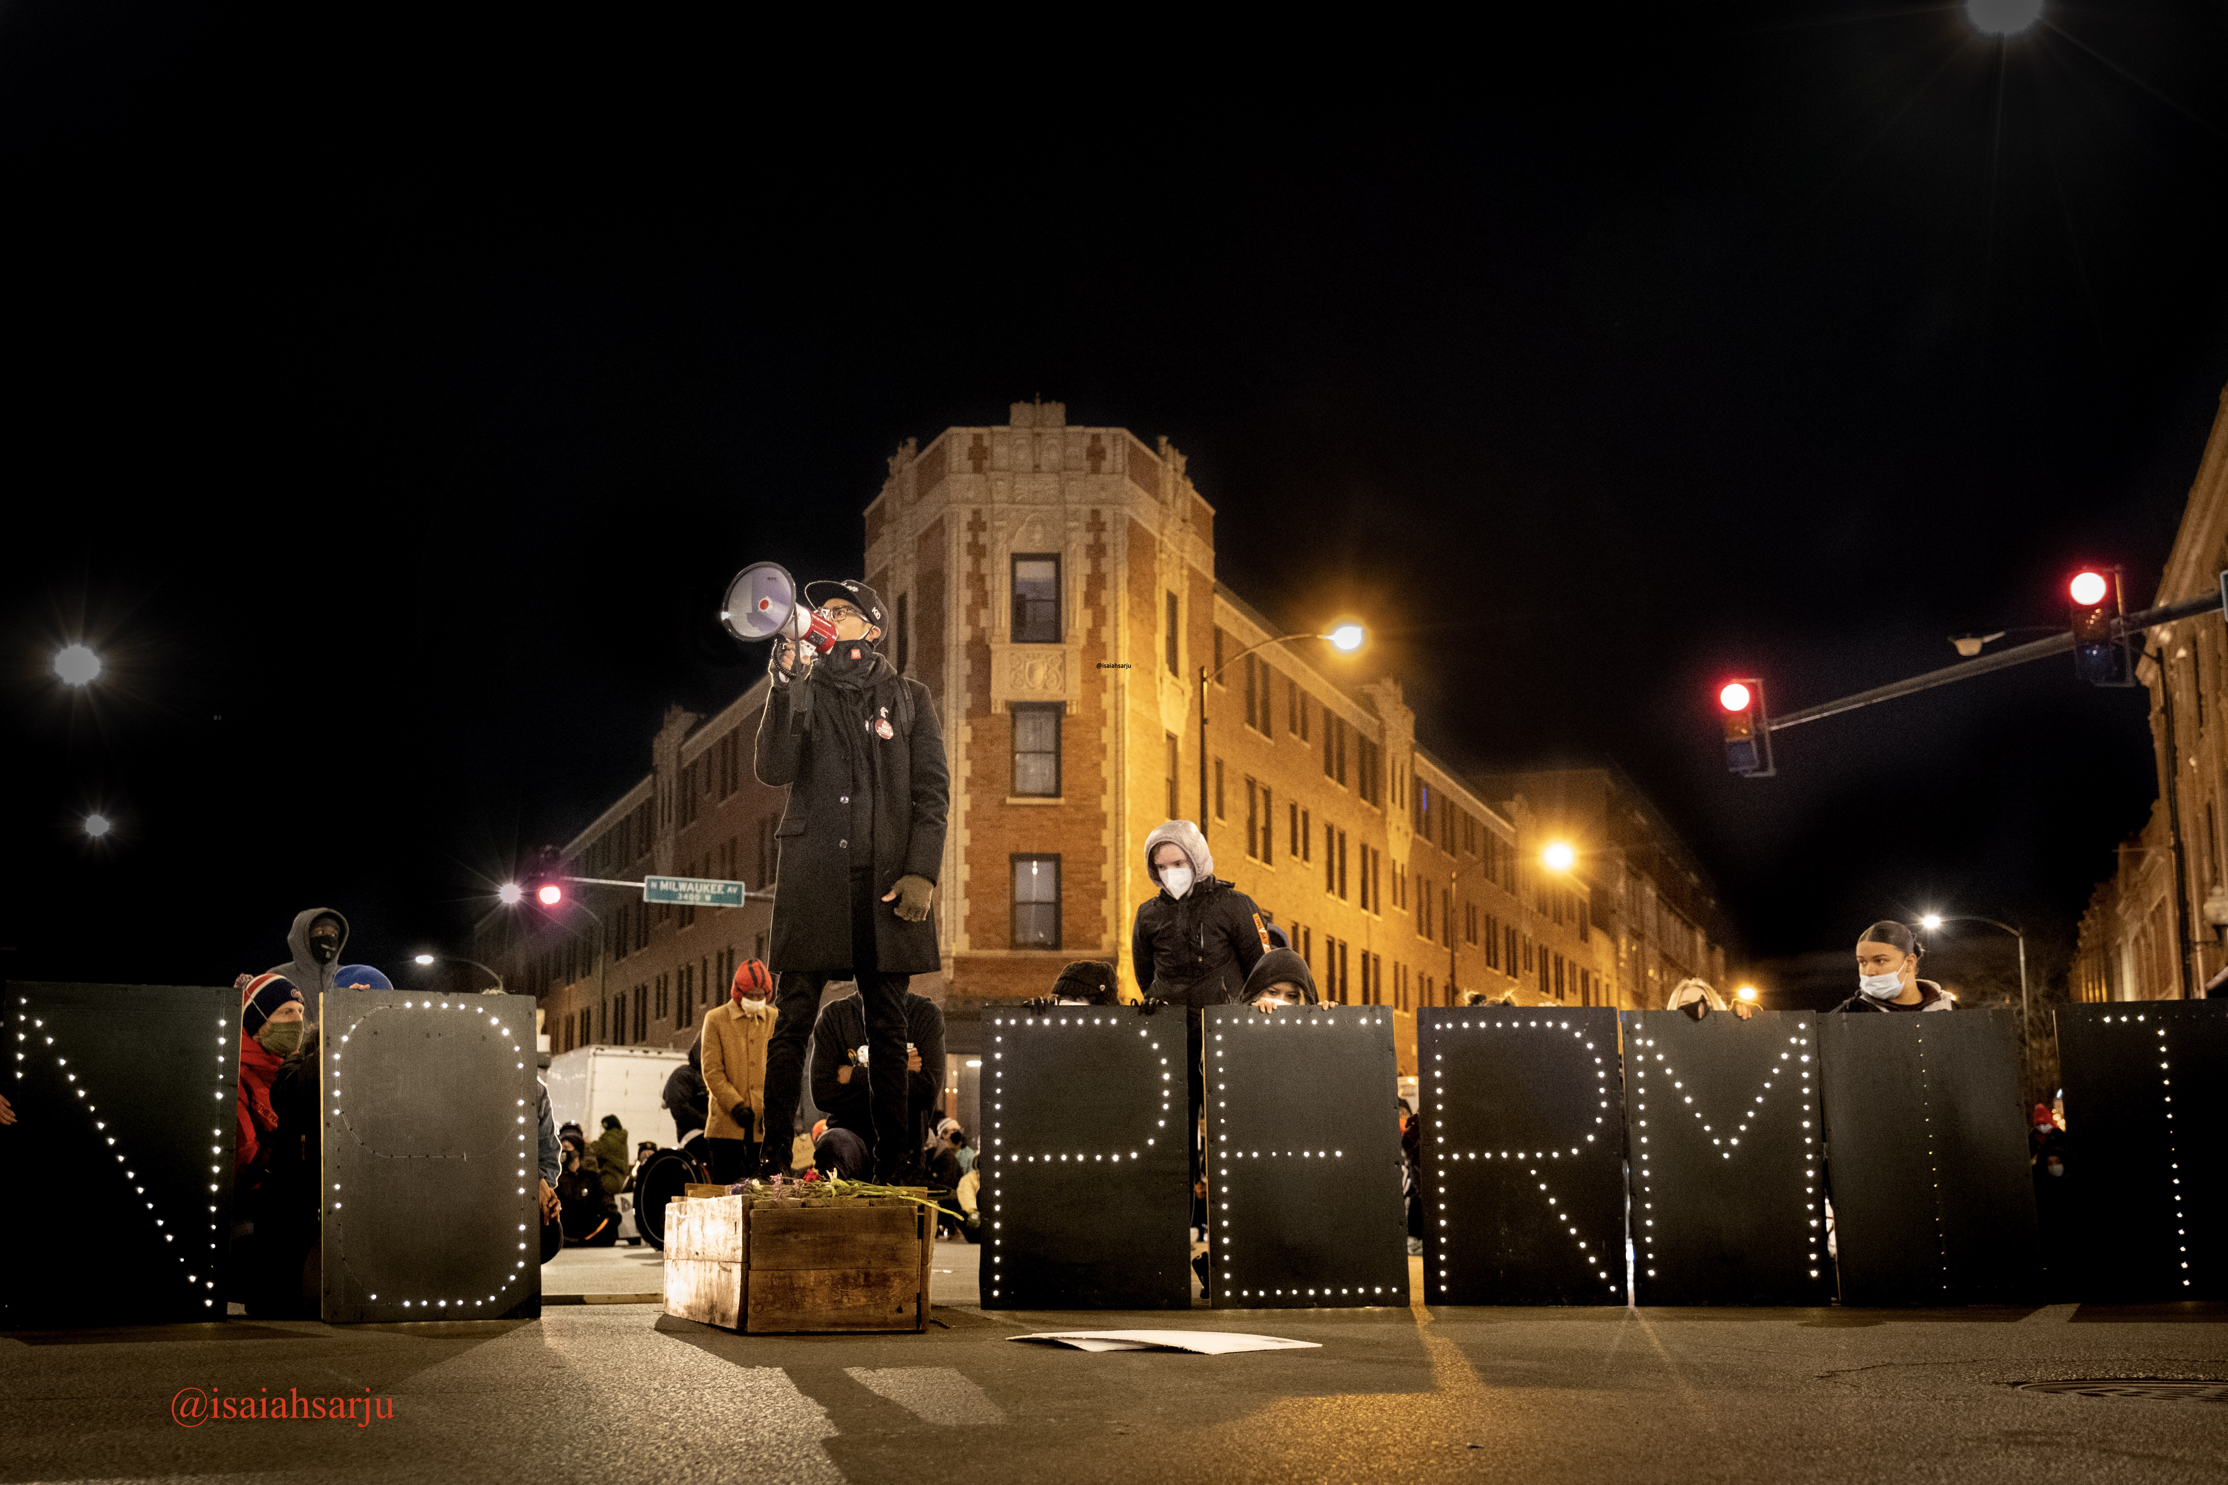
Notes:
Protest march,

Slide 12
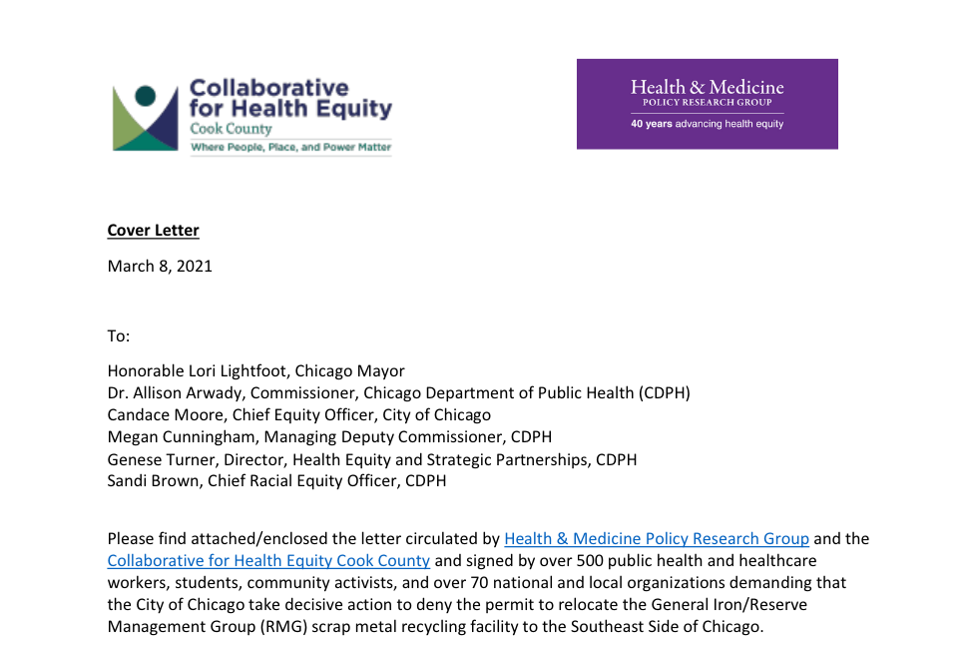
“We demand that CDPH follow its own community health improvement plan 'Healthy Chicago 2025’ and prioritize environmental justice, racial equity, and health equity in its actions.”
Open letter to Mayor Lightfoot & Commissioner Arwady, March 8, 2021
Signed by over 70 organizations & over 500 individuals

Slide 13
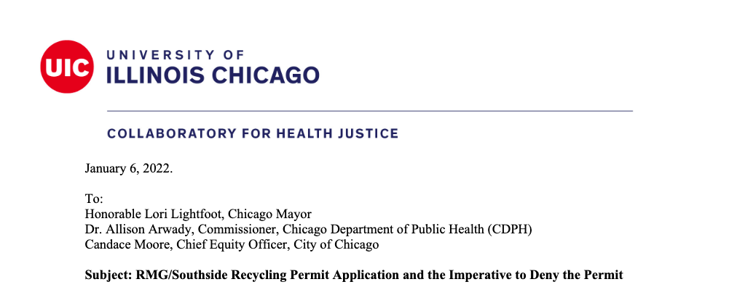
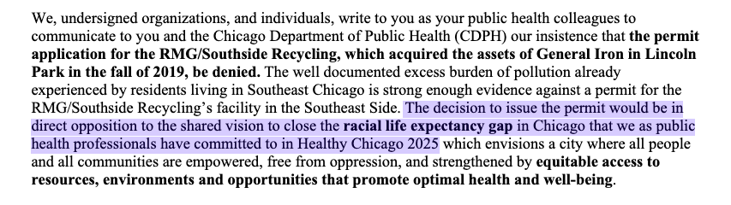
Notes:
Daisy G Magana, Victoria Persky, Jeni Hebert-Beirne Serap Erdal
UIC Dean of the school of Public Health Wayne Giles
"k-harley@law.northwestern.edu" <k-harley@law.northwestern.edu>

Slide 14
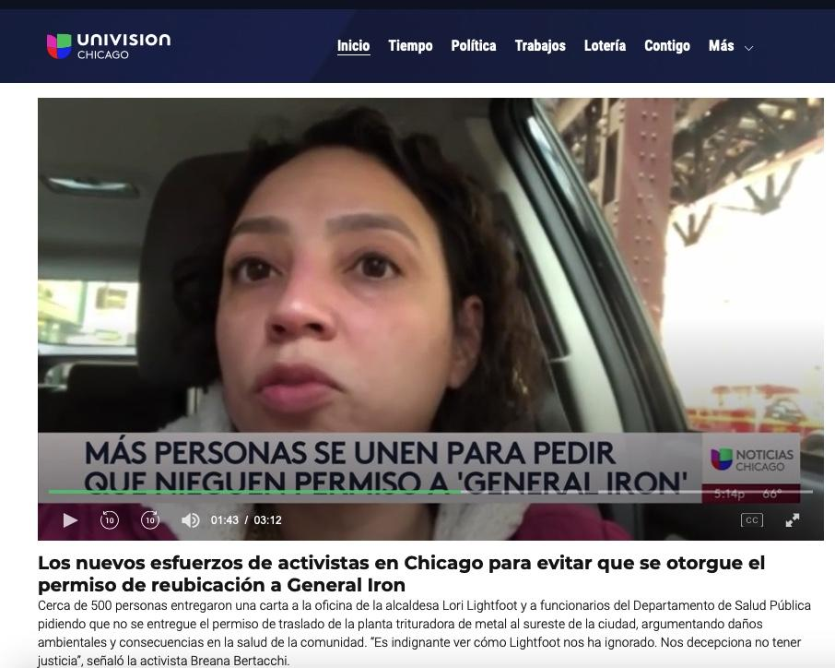
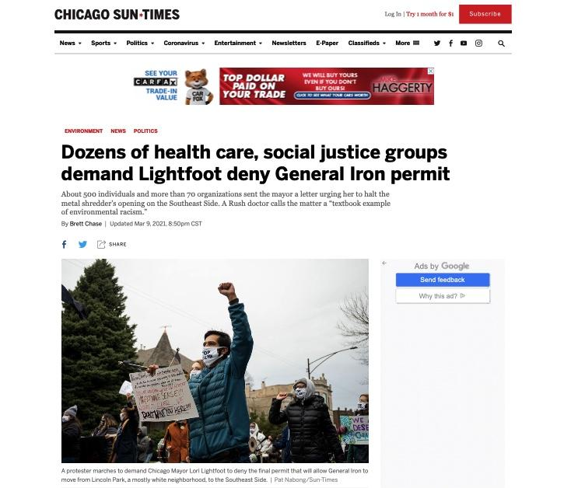
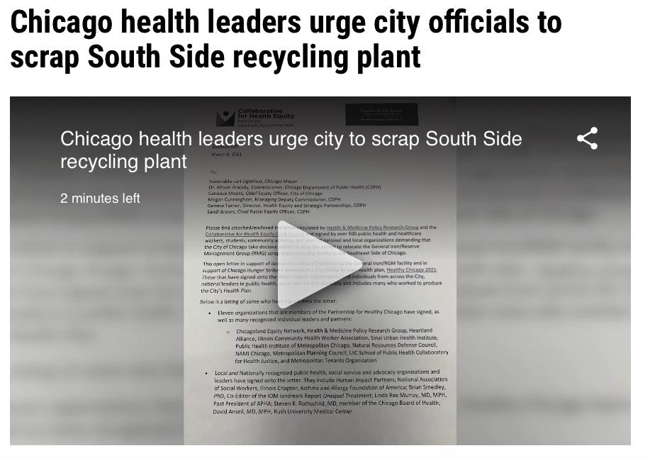
Media Coverage of March 8, 2021 Health Community #DenyThePermit Public Letter of March 8, 2021
Notes:
Sun-times article: https://chicago.suntimes.com/2021/3/9/22322140/general-iron-southeast-side-rmg-rush-esperanza-health-centers-sinai-urban-health-institute

Slide 15
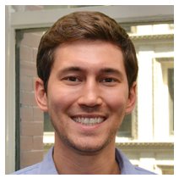
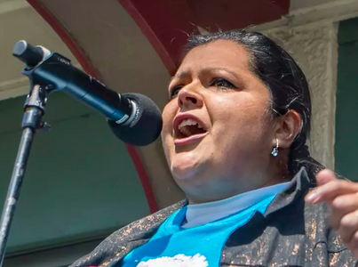
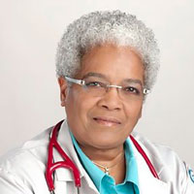

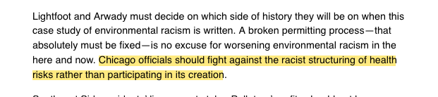
Wesley Epplin, Olga Bautista, Linda Rae Murray, MD, MPH, FACP (L to R), March 9, 2021 Crain’s Chicago Business Op-Ed.
“Chicago officials should fight against the racist structuring of health risks rather than participating in its creation.”

Slide 16
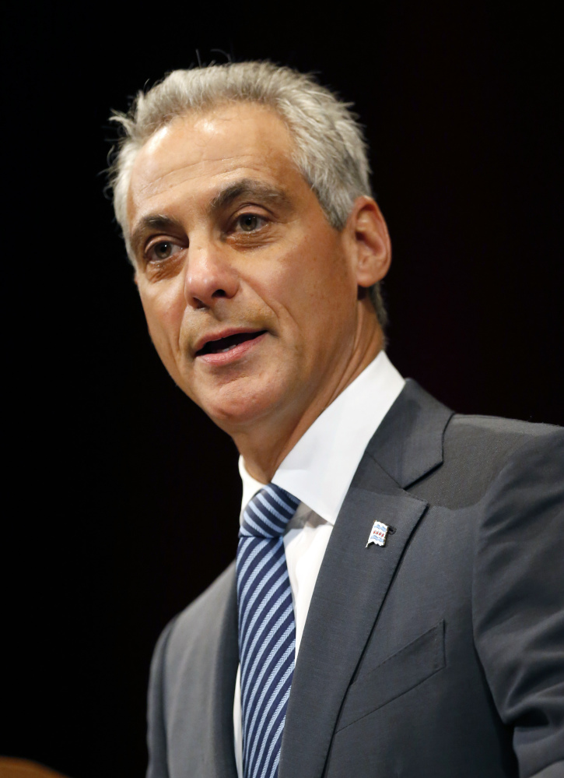
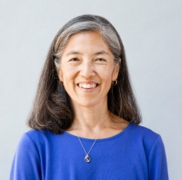
Former CDPH Commissioner Julie Morita, MD
Former Mayor Rahm Emanuel
“The researcher is very connected to the environmental advocacy groups and is not someone I can reason with…You may need to engage the Chancellor if you want this to be stopped.” Julie Morita, Commissioner, Chicago Department of Public Health, May 2, 2018 e-mail to David Reifman
Source: Hawthorne, M. (2020). Five Julie Morita Emails 2018. Chicago Tribune. Retrieved from https://www.documentcloud.org/documents/6772921-2018-5-Julie-Morita-Emails.html

Slide 17
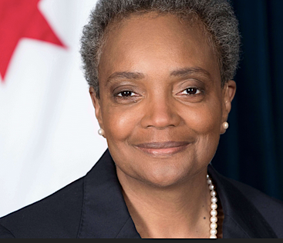
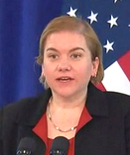

Commissioner Allison Arwady
Mayor Lori Lightfoot
“…thank you for the input that you have provided on the Southside Recycling permit application so far – and for invoking Healthy Chicago 2025 to ensure that CDPH and the City are accountable to our health and racial equity commitments. At the same time, we recognize that the issues at play here are much larger than a single facility, or even a community.
Commissioner Allison Arwady, MD, MPH (March 18, 2021 ‘Dear Colleagues’ Letter)

Slide 18
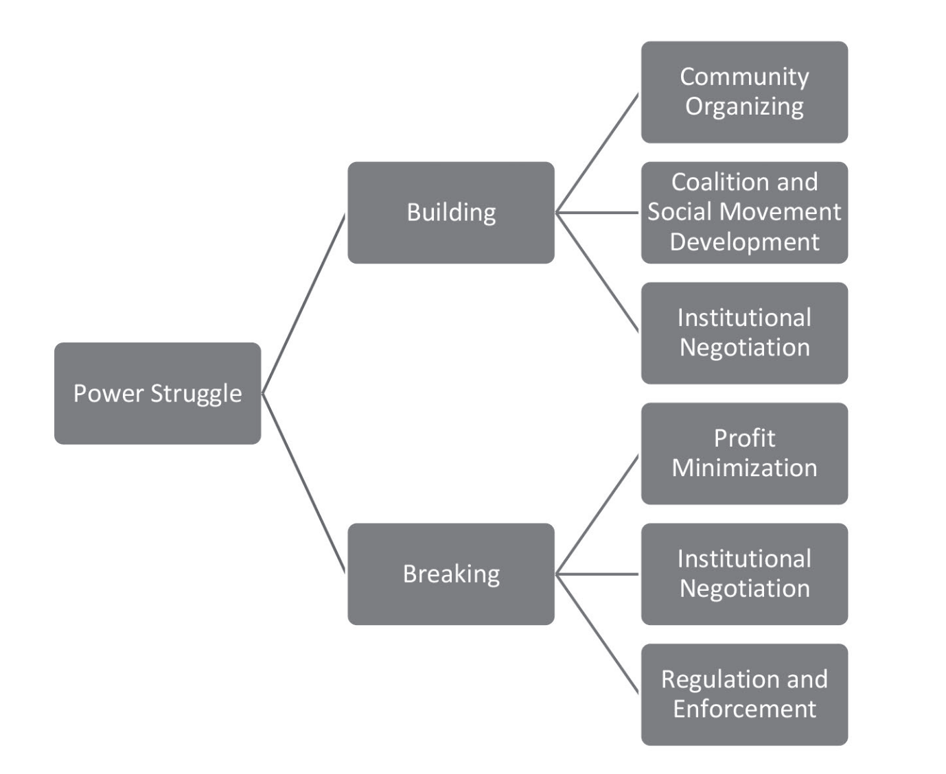
Health justice through the lens of power (Michener 2022)
Michener, J. (2022). Health Justice Through the Lens of Power. Journal of Law, Medicine & Ethics, 50(4), 656–662. https://doi.org/10.1017/jme.2023.5

Slide 19
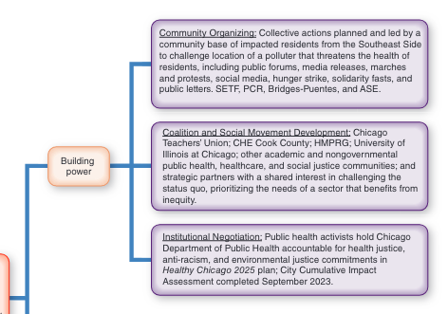
Building Power: Michener’s Lens of Power idea (2022) applied to the
#StopGeneralIron struggle for environmental justice in Chicago
Sources: Bloyd, J. (Sept 28, 2024). Organizing for Environmental Health and Justice: Lessons from #StopGeneralIron. In Environmental Health: Foundations for Public Health (1st ed.). Springer. Michener, J. (2022). Health Justice Through the Lens of Power. Journal of Law, Medicine & Ethics, 50(4), 656–662. https://doi.org/10.1017/jme.2023.5 ;
Notes:
Health justice through the lens of power (Michener 2022)
Michener, J. (2022). Health Justice Through the Lens of Power. Journal of Law, Medicine & Ethics, 50(4), 656–662. https://doi.org/10.1017/jme.2023.5
Sampson, N., Tallon, L., & DeJarnett, N. (2024). Environmental Health Foundations for Public Health (1st ed.). Springer. https://www.springerpub.com/environmental-health-9780826183521.html#description

Slide 20
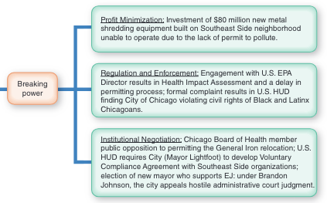
Breaking Power: Michener’s Lens of Power idea (2022) applied to the
#StopGeneralIron struggle for environmental justice in Chicago
Sources: Bloyd, J. (Sept 28, 2024). Organizing for Environmental Health and Justice: Lessons from #StopGeneralIron. In Environmental Health: Foundations for Public Health (1st ed.). Springer. Michener, J. (2022). Health Justice Through the Lens of Power. Journal of Law, Medicine & Ethics, 50(4), 656–662. https://doi.org/10.1017/jme.2023.5 ;
Notes:
Health justice through the lens of power (Michener 2022)
Michener, J. (2022). Health Justice Through the Lens of Power. Journal of Law, Medicine & Ethics, 50(4), 656–662. https://doi.org/10.1017/jme.2023.5

Slide 21
HUD found Chicago to be in violation of the US Civil Rights Act of 1964 (US HUD 2022)
“In 2016, as the City began engaging with General Iron, the City launched its Industrial Corridor Modernization Initiative to “guide future public and private investments.”...the City designated all but three of the Industrial Corridors as “Receiving Corridors,” meaning that in those areas the City would “reinforc[e] traditional industrial activities.”...The Industrial Corridors not designated as Receiving Corridors are disproportionately White...the twenty-three designated as Receiving Corridors are collectively 20% White. By contrast, the three Industrial Corridors not designated as Receiving Corridor are collectively 68% White.”
Source: Gaige, J., & US Department of Housing and Urban Development. (2022, July 19). Letter of Findings of Noncompliance with Title VI and Section 109 Southeast Environmental Task Force, et al. V. City of Chicago Case No. 05-20-0419-6/8/9. https://www.hud.gov/sites/dfiles/Main/documents/Letter_of_Finding_05-20-0419_City_of_Chicago.pdf p14

Slide 22
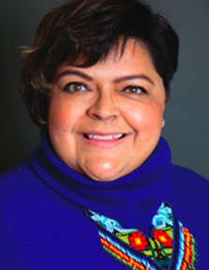
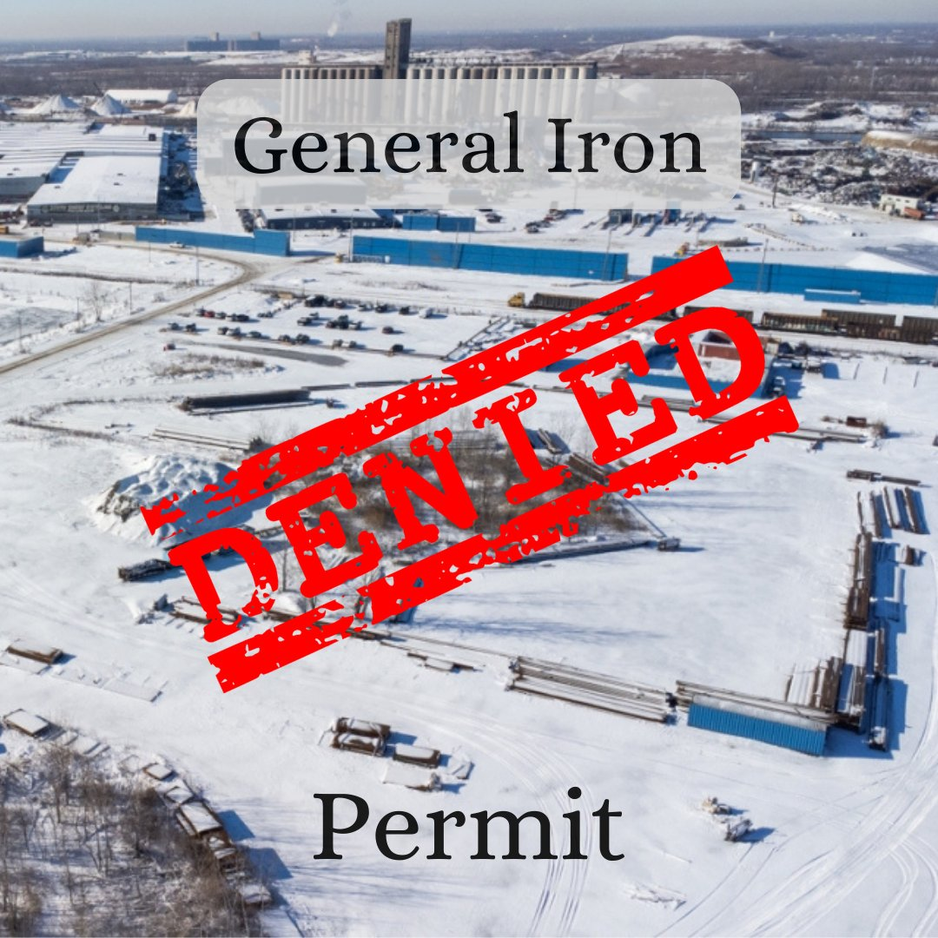
“This is what environmental justice looks like.”
Michael Regan, Administrator EPA, February 18, 2022
US EPA, O. (2022, February 18). Statement from Administrator Regan on RMG Permit Denial by the City of Chicago [News Release]. https://www.epa.gov/newsreleases/statement-administrator-regan-rmg-permit-denial-city-chicago
“. . . millionaires and billionaires aren’t used to losing. So I think that they’re feeling it now. That is not enough if you can have organized money, but we have organized people. And in this case, enough organized people to win, to prevent this relocation.”
— Olga Bautista, Organizer, Southeast Environmental Task Force
Olga Bautista
Notes:
CHE Cook County Letter (lower right) Signed by over 70 organizations & over 500 individuals, Open letter to Mayor Lightfoot & Commissioner Arwady, March 8, 2021. “We demand that CDPH follow its own community health improvement plan 'Healthy Chicago 2025’ and prioritize environmental justice, racial equity, and health equity in its actions.”
Source: Krieger, Nancy. (2021). Ecosocial Theory, Embodied Truths, and the People's Health (Small Books Big Ideas in Population Health) (p. 54). Oxford University Press. Kindle Edition

Slide 23

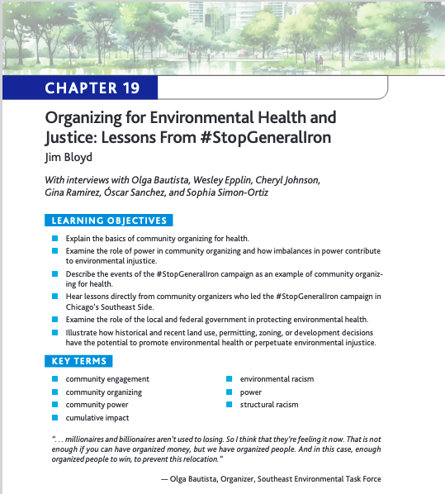
To read in depth interviews of #StopGeneralIron organizers, ask me for a free pdf copy of the chapter in a new EJ text book (Sept ‘24)
Jim Bloyd, DrPH MPH he/him
JimBloyd@gmail.com
Leadership Team, Collaborative for Health Equity Cook County (CHECookCounty.org)
Regional Health Officer (Ret.), Cook County Department of Public Health; Former instructor, University of Illinois at Chicago School of Public Health
Bloyd, J. (2024). Organizing for Environmental Health and Justice: Lessons from #StopGeneralIron. In N. Sampson, T. Lindsay, & N. DeJarnett (Eds.) Environmental Health: Foundations for Public Health (1st ed., pp. 445-469). Springer. https://connect.springerpub.com/content/book/978-0-8261-8353-8

